Slide 1

Visvesvaraya
National Institute Of Technology
Nagpur
Problem Statement : Affordable Mobile Application Camera System to Monitor Vehicle Activity
Create an affordable solution of a mobile application and a camera system through image processing to identify and monitor vehicles entering and leaving a residential society passing through the entry/exit gate.
Company Name : HawkEye
Team Members: Chaitya Chheda
Deval Media
Kapeel Suryavanshi
Ritwik Deshpande
Ayush Singh

Slide 2
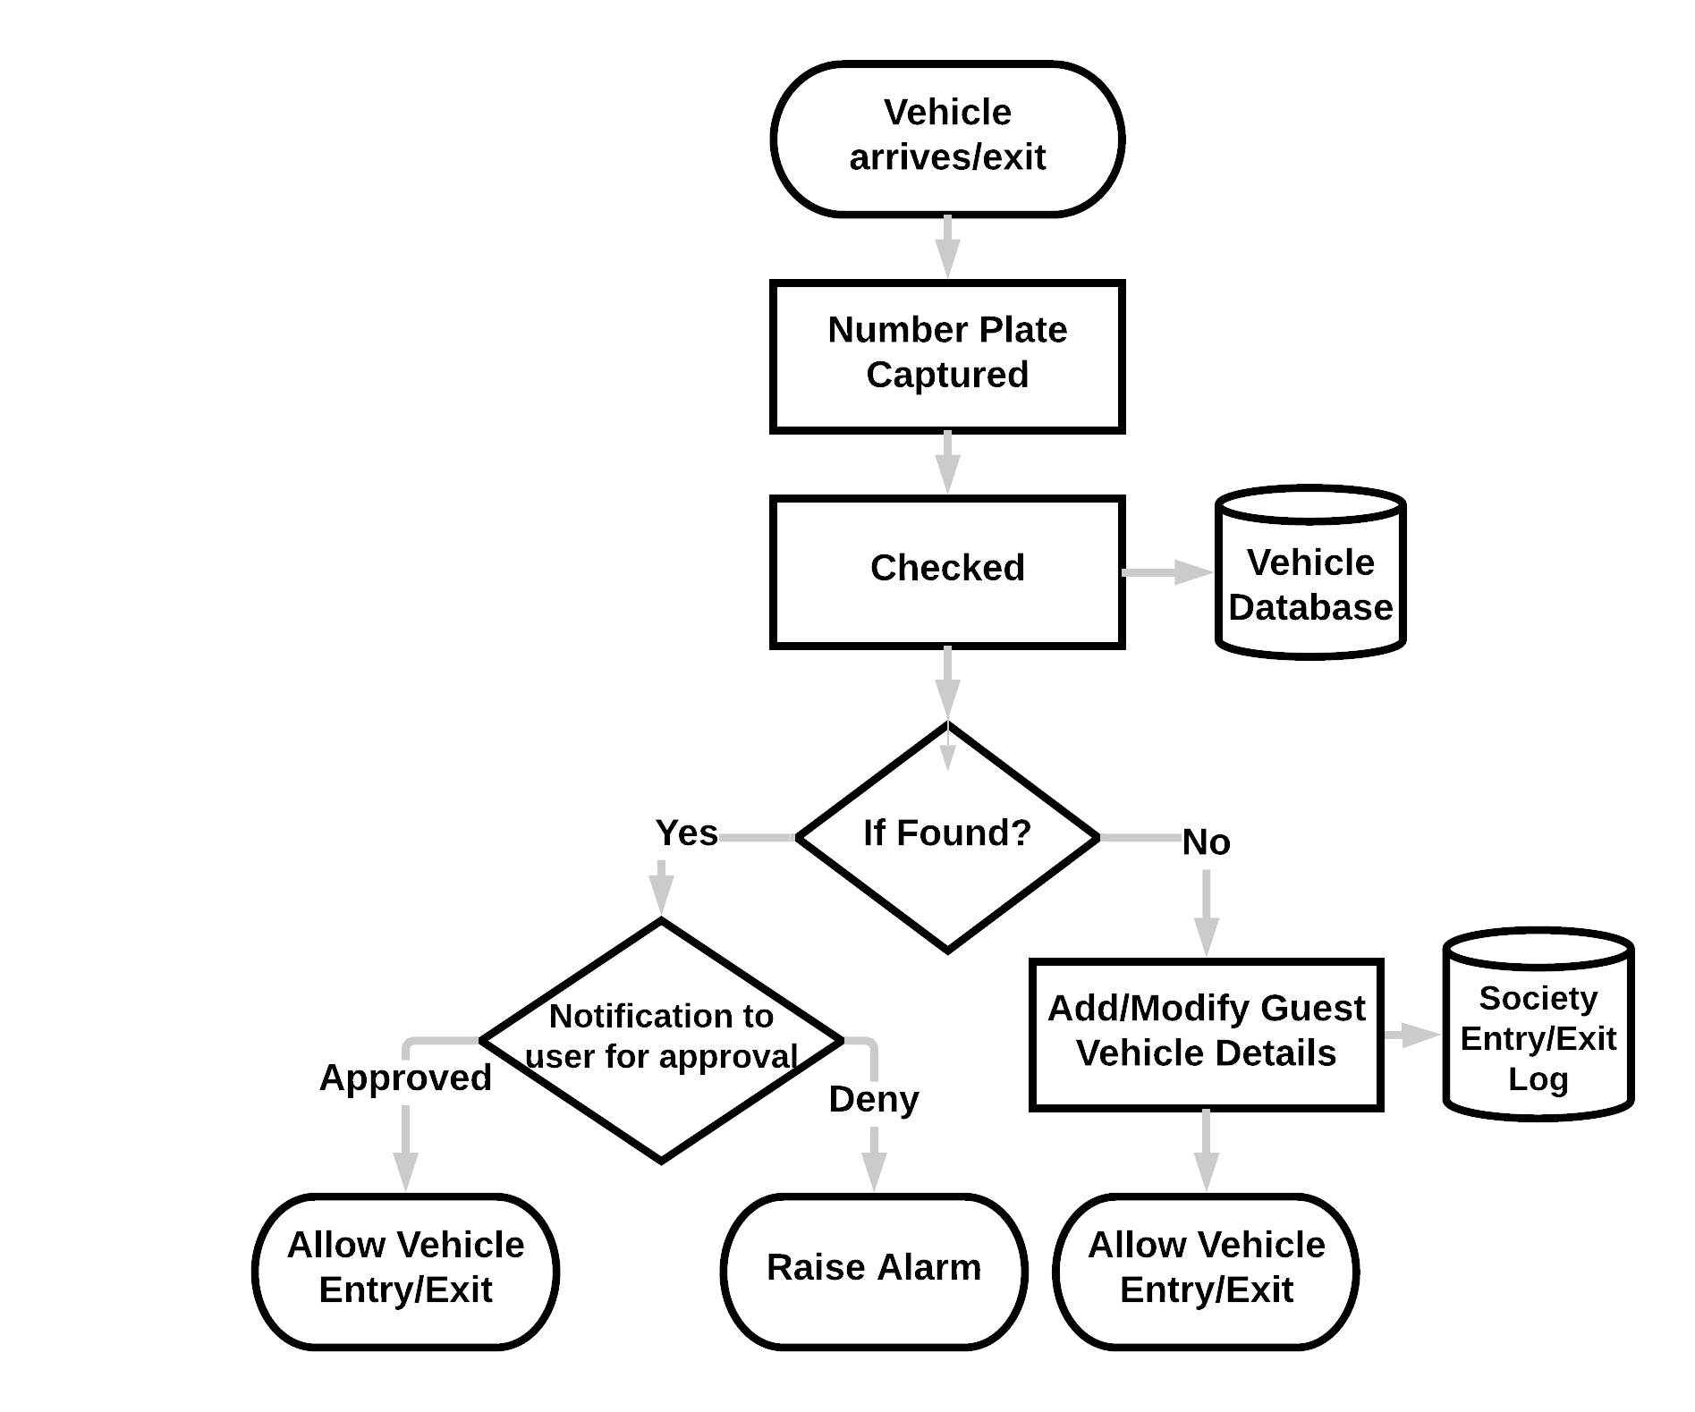
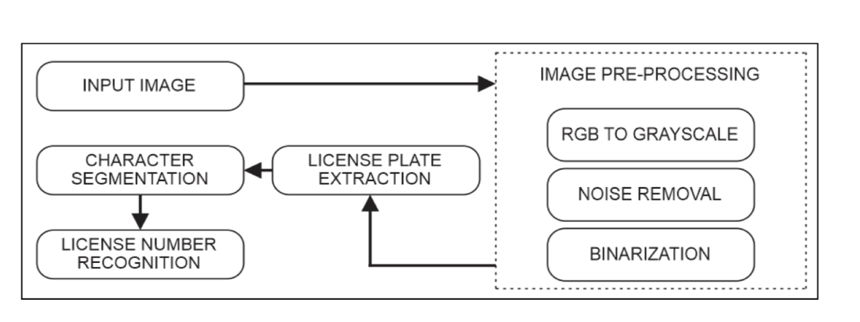
Solution
A mobile application which monitors residential societies’ vehicle activity. There will be an Admin Login (Secretary) and User Login. User can add/delete vehicles accordingly, for himself/herself or guest which is approved by the Admin.
Whenever a vehicle enters/exits, an LPR (License Plate Recognition) CCTV camera captures the video of the vehicle which is converted into frames followed by conversion to images.
Information Extracted
Number Plate
Color
Company of Car
Our System will identify the registration number from the number plate with the one registered and stored in the database.
Accordingly it will authenticate the vehicle, sending a notification
to the appropriate user that car has arrived/left the society.
The user may approve/deny the entry/exit of the vehicle.
Similarly, the user can permit vehicles of guest arriving/departing.

Slide 3







Technology Stack
Features
Improved security of the resident society.
Provide analytics to the security/management.
Monthly Bill Payment, Society notices, important local news etc.
Support for both English and Hindi.
Automate the process of guard shifts management.
Future Scope
Can be implemented in shopping complexes, corporate offices, universities etc.
Using RFID for vehicle identification.
Robust API for automatic parking system.
Entry/Exit Log made available to law enforcement agencies for identifying suspicious activities.
Revenue
Our Platform
Collecting and selling user vehicle data.
In-app Advertising.
Maintenance from society fund.
Society
Charges imposed on exceeding number of vehicles of registered user.
Collaborating with apps like Airbnb to acquire a share of their revenue as parking charges.
App Development S/W
and Database
License Plate Number Recognition using OCR and Neural Network
Payment SDK

Slide 4
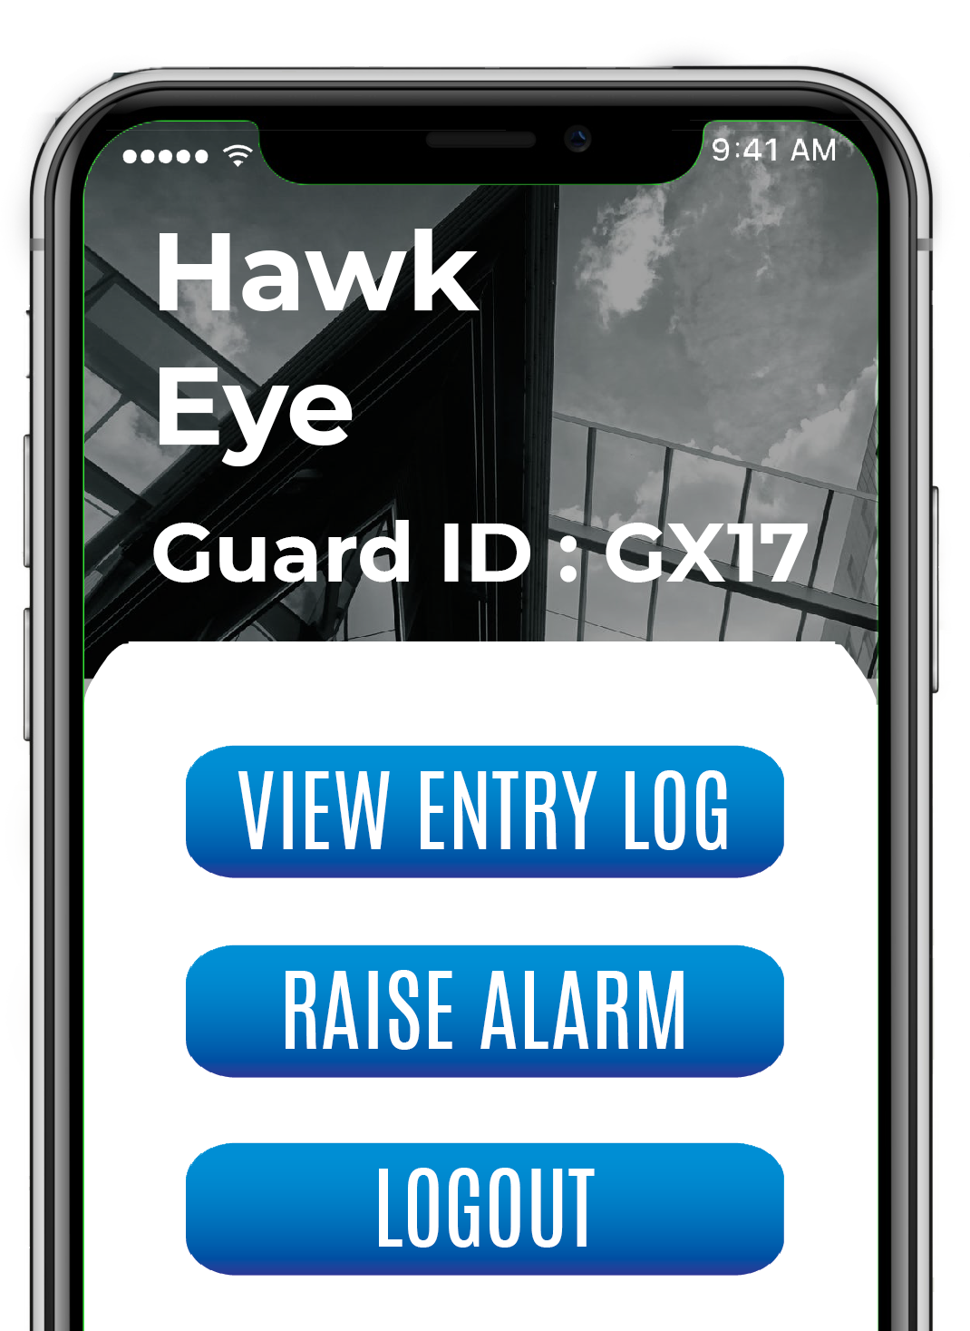
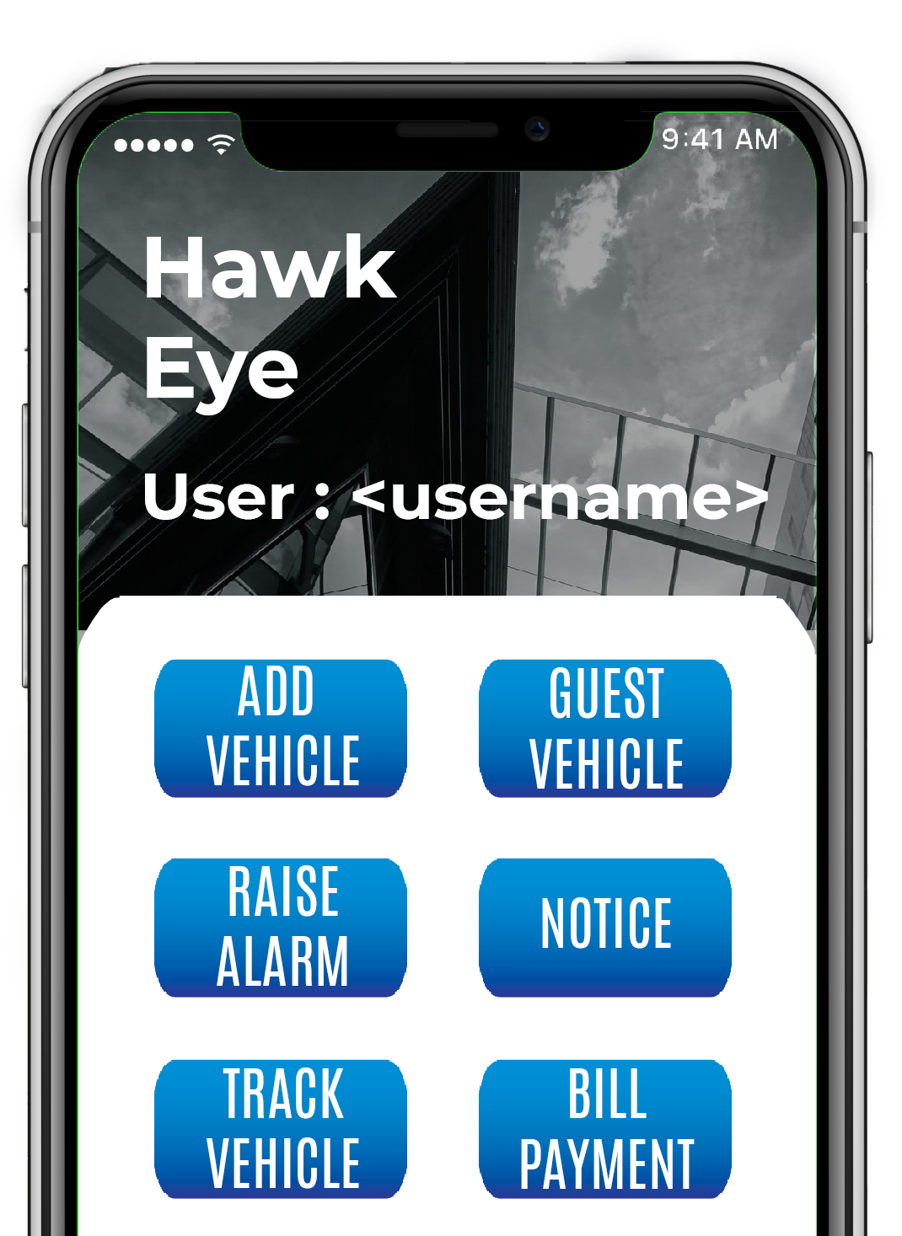
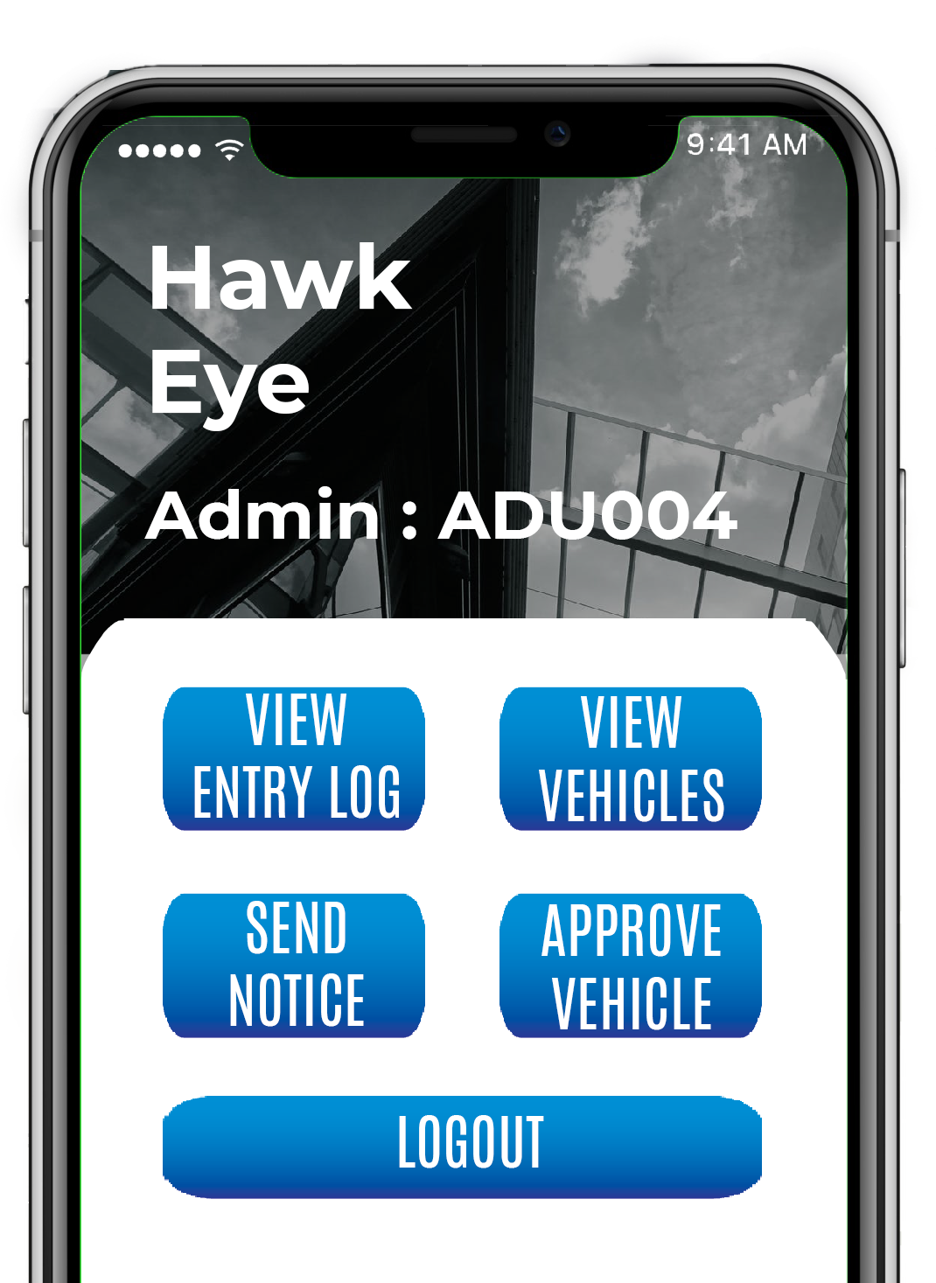
Stakeholders
Security
Guard
User
Resident of campus.
Students
Cab Drivers
Admin
Security Section Personnel
Features
Features
Features

Slide 5
Dependencies
Physical
Cooperation and acceptance by society.
Guards capable of reading and operating the application.
Software
Python Libraries- scikit,, scipy, numpy, matplotlib, Pillow, tensorflow.
Payment APIs
Accuracy of detection technologies to be used.
Database - Firebase
Hardware/Computing Services
CCTV Camera
Smartphone with internet connection.
Cloud Services for computations.

